Slide 1
DECEPTION DETECTION
GROUP : 56
RAHUL GOEL
SWAPNIL VERMA
STANZIN GYALPO

Slide 2

Addressing Deception Detection
in Diplomacy Negotiations
This presentation explores machine learning and deep learning techniques for deception detection in Diplomacy, a strategic game involving complex communication and negotiation. The project addresses the significant challenge of class imbalance, where deceptive messages vastly outnumber truthful ones. We aim to improve the detection of truthful messages using advanced models and techniques.

Slide 3
Introduction: Deception in Diplomacy
Strategic Communication
Deception Detection
Class Imbalance
Diplomacy involves strategic communication, negotiation, and deception. Players exchange messages to form alliances, coordinate actions, and misrepresent information to achieve victory.
Detecting deception in these messages is valuable for creating sophisticated AI agents and understanding human interactions. However, deception is subtle and context-dependent.
Datasets from these interactions often exhibit severe class imbalance, with truthful messages being far less common than deceptive ones, hindering model performance.
GROUP-56 NLP

Slide 4




Related Work: Deception Detection Techniques
Early Research
Deep Learning
Focused on identifying linguistic or non-verbal cues, with mixed success. Linguistic feature-based approaches combined with classifiers like SVMs were common.
Leveraged CNNs or LSTMs to automatically learn relevant features from text sequences. Pre-trained Transformers like BERT and RoBERTa significantly advanced NLP capabilities.
Strategic Settings
Detecting lies in goal-oriented dialogues is distinct from identifying factual inaccuracies. Research exists on deception in social deduction games and negotiation dialogues.
GROUP-56 NLP

Slide 5

Handling Class Imbalance in NLP
Data-Level Techniques
Algorithm-Level Approaches
Rebalance the class distribution before training using methods like Random Over-Sampling (ROS), Random Under-Sampling (RUS), and synthetic sample generation like SMOTE.
Modify the learning process, such as cost-sensitive learning via class weighting in the loss function, penalizing errors on the minority class more heavily.
Ensemble Methods
Combine multiple models to improve robustness on imbalanced data. Specialized loss functions like Focal Loss focus training on hard-to-classify examples.

Slide 6





Methodology: Data Preprocessing
Lowercase Conversion
Convert all message texts to lowercase.
URL Removal
Remove URLs using regular expressions.
HTML Tag Removal
Remove potential HTML tags.
Non-Alphanumeric Removal
Remove non-alphanumeric characters, preserving whitespace for TF-IDF models.

Slide 7
Baseline Models: TF-IDF + SMOTE + ML
TF-IDF Features
SMOTE Application
ML Classifiers
Extracted from preprocessed text using 'max_features = 5000' and 'ngram_range = (1, 2)'.
Applied to the TF-IDF training features to create a balanced training set.
Logistic Regression, Random Forest ('n_estimators = 100'), and Multinomial Naive Bayes were used.
GROUP-56 NLP

Slide 8




Baseline Models: RoBERTa + DistilBERT Ensemble
Upsampling
Fine-Tuning
Ensemble Prediction
Upsampled the minority class in the training data.
Independently fine-tuned RoBERTa-base and DistilBERT-base models using class weights.
Made by averaging probabilities. A custom probability threshold was tuned on the validation set.
GROUP-56 NLP

Slide 9



Baseline Models: RoBERTa + Class Weighting
Fine-Tuning
2
Fine-tuned a standard 'roberta-base' model using a custom 'WeightedTrainer'.
Target Dataset
1
Used the target dataset without any resampling.
Class Weights
Applied class weights inversely proportional to class frequency in the original training set.
3
GROUP-56 NLP

Slide 10
Proposed Final Model: Focal Loss Enhanced RoBERTa
Motivation
1
Standard cross-entropy loss, even weighted, can be overwhelmed by numerous, easily classified majority examples.
Focal Loss
2
Aims to mitigate this by dynamically scaling the loss, focusing on harder truthful examples.
Implementation
3
Integrated Focal Loss with γ=2 and α=0.25 into a custom Trainer, modifying the model's forward pass.
GROUP-56 NLP

Slide 11
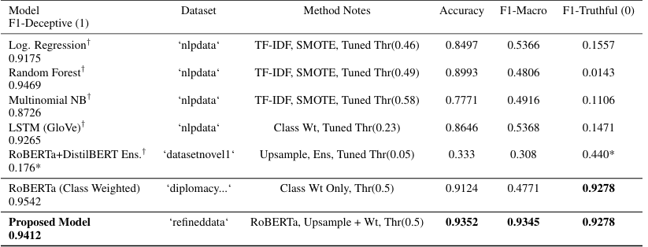
FINAL RESULTS
GROUP-56 NLP

Slide 12



Conclusion and Future Work
Improvement
1
Focal Loss enhanced RoBERTa significantly improved F1-Truthful score.
Future
2
Incorporate game state, explore data augmentation, and investigate graph neural networks.
Challenge
3
Detecting deception in Diplomacy remains a challenging task.
GROUP-56 NLP

